Slide 1
Lawyer.AI

Slide 2
References for background of ChatGPT
https://medium.com/@samyukthakrishna3/what-is-chatgpt-6bfd69b5f6bb
https://medium.com/@christianmartinezfinancialfox/how-does-chatgpt-works-from-a-technical-perspective-58750ddcdea8

Slide 3
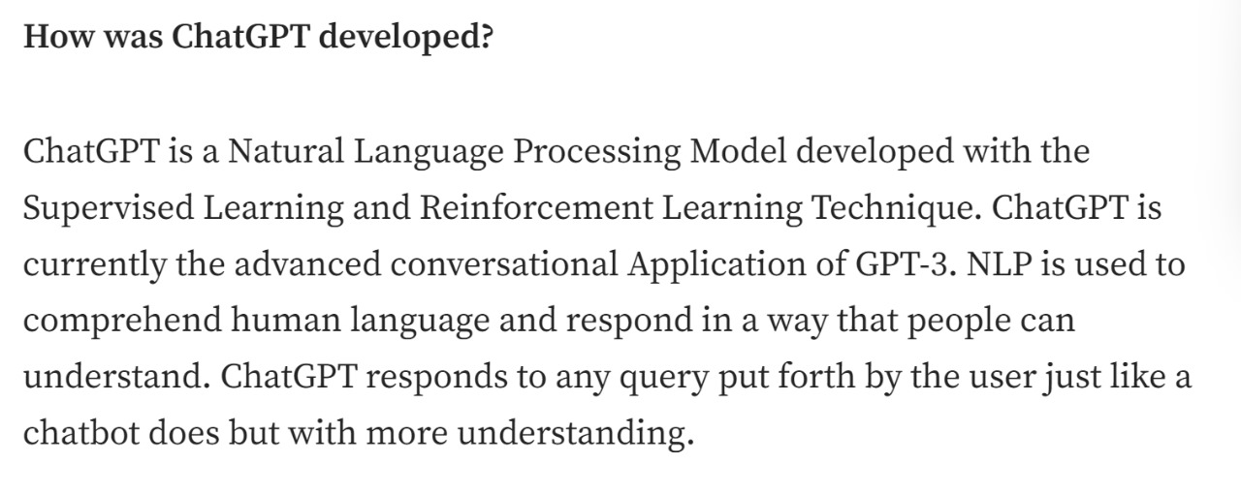
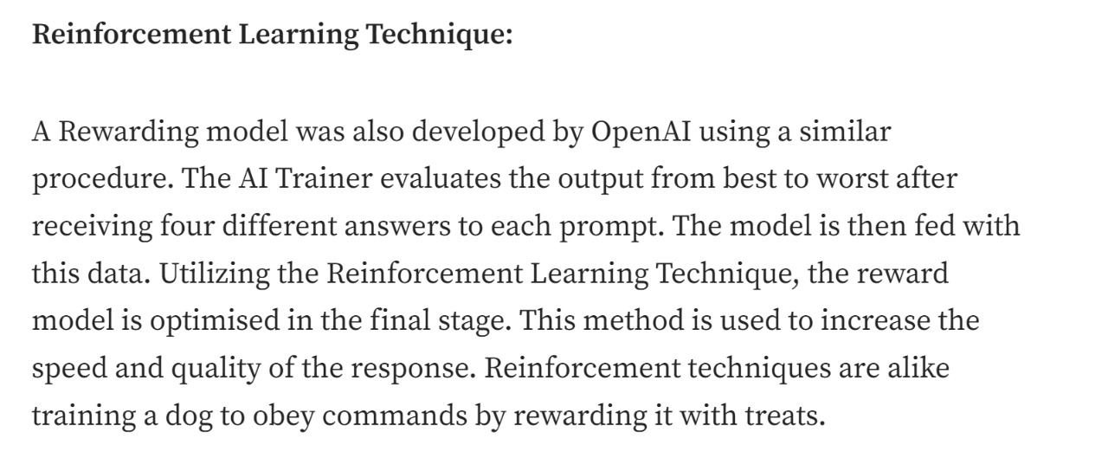

Slide 4
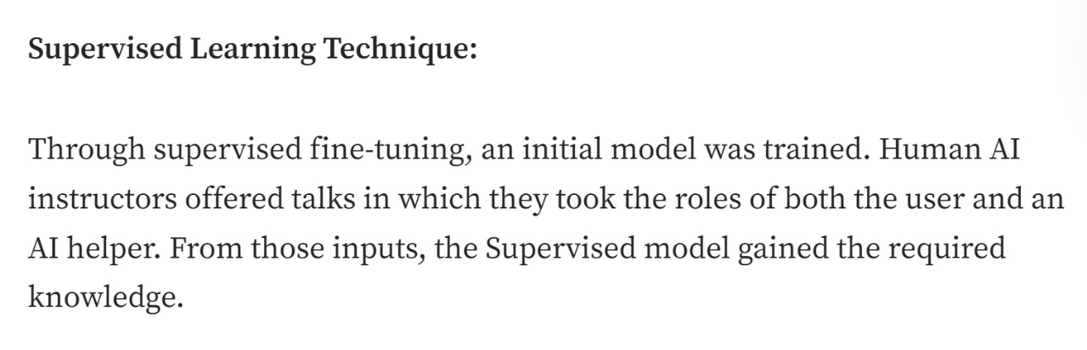
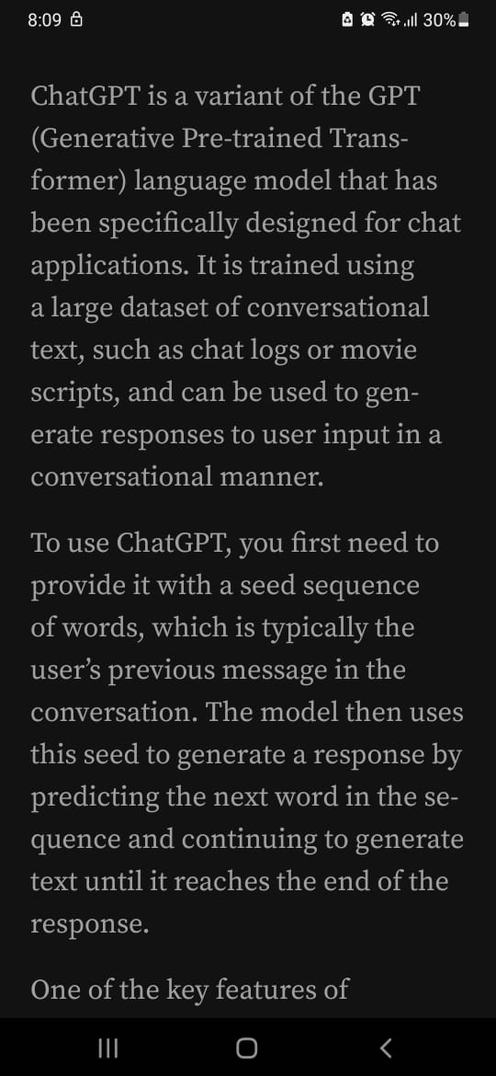
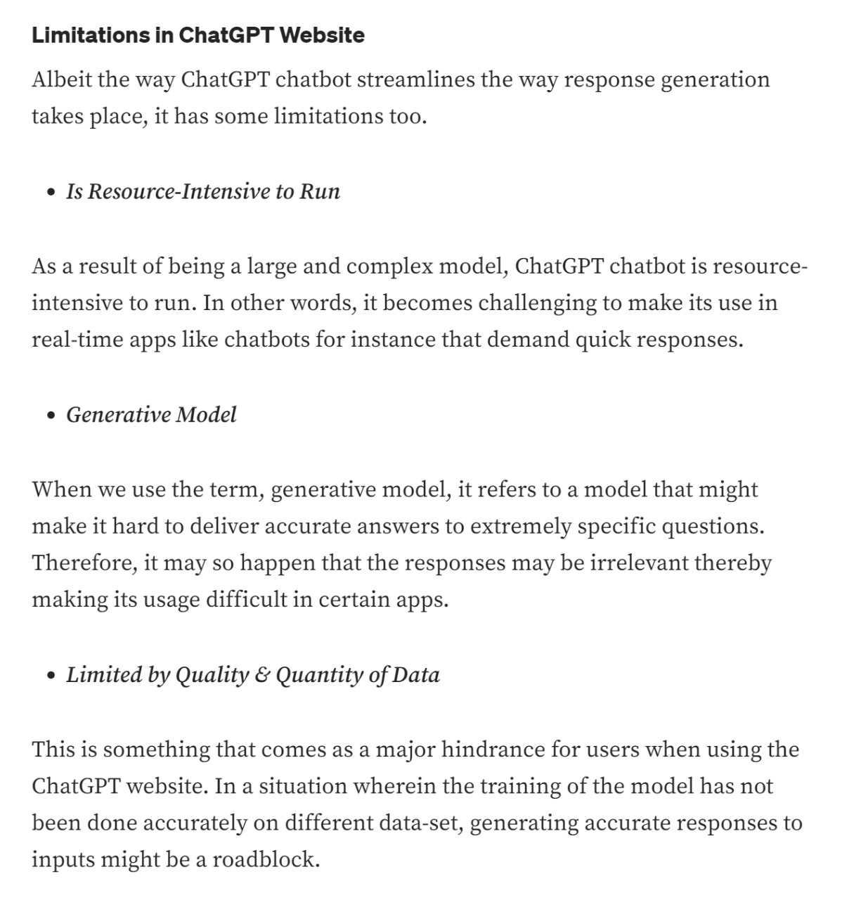

Slide 5
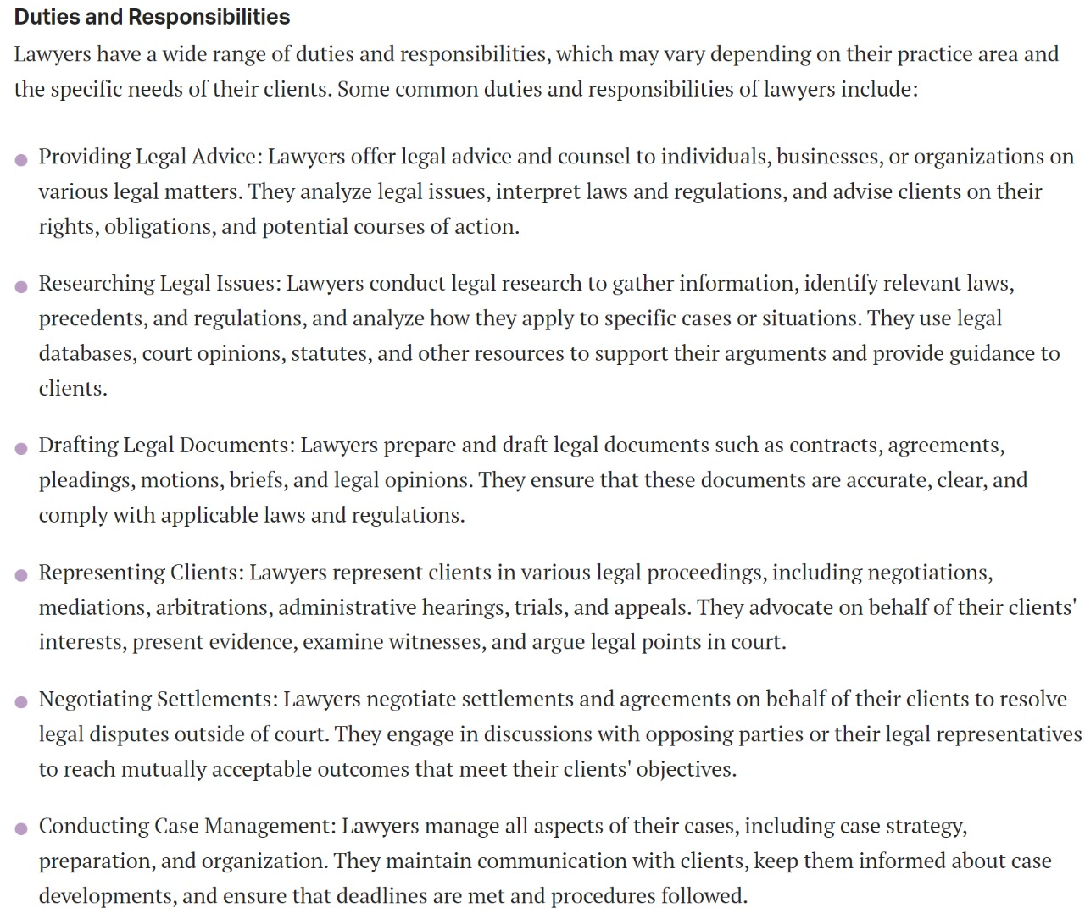
What does Lawyer do?
https://www.careerexplorer.com/careers/lawyer/

Slide 6
Following are the ways Lawyer.AI is better than human Lawyer.
• AI-powered Legal Assistant
• Legal Research
• Document Suggestion Platform
• Linked In for Lawyers
• Lawyer suggestion who has fought/assisted in similar matters

Slide 7
The “Lawyer.AI" project leverages artificial intelligence to transform the legal field by providing accessible, efficient, and reliable legal support. This system integrates Natural Language Processing and machine learning algorithms to assist both legal professionals and the public in navigating complex legal information. The core functionality includes real-time legal advice. It is done by analyzing vast amounts of legal data. It aims to enhance decision making processes, streamline legal research, and reduce the workload for lawyers. The project addresses the need for affordable legal services and aims to bridge the gap between complex legal systems and the general public. We also aim to educate normal people in regards of legalities and make them comfortable with legal system of India

Slide 8
DEFINITION

Slide 9
Lawyer.AI refers to the application of artificial intelligence (AI) technologies in the field of law, aiming to assist or automate various legal processes. This concept has a broad range of tools and systems designed to support Public and legal professionals in tasks that traditionally require human expertise.
1.Document Suggestion: AI can automate the Suggestion of legal documents such as contracts, wills, and briefs. By inputting key variables, AI Suggest documents, saves time and reducing human error.
2. Virtual Assistants
Client Interaction: AI-driven chatbots and virtual assistants can handle initial client inquiries, provide legal information, and even guide clients through simple legal processes, freeing up lawyers for more complex tasks.

Slide 10
3. Ethics and Legal Implications
Bias in AI: One of the challenges with Lawyer.AI is ensuring that AI systems do not perpetuate biases present in the data they were trained on.
Regulation of AI in Law: There are ongoing debates about how AI should be regulated in the legal industry, including concerns about the unauthorized practice of law by AI systems and the need for transparency in AI decision-making processes.
4. Future Prospects
Augmentation, Not Replacement: The role of Lawyer.AI is generally seen as augmenting the work of human lawyers rather than replacing them. AI handles repetitive, time-consuming tasks, allowing lawyers to focus on strategic and complex aspects of their work.
Continuous Learning: AI systems in law are constantly evolving, learning from new data and legal developments, which means they will continue to improve and expand their capabilities over time.

Slide 11
Understanding the purpose of the "Lawyer.AI" project.
→The main aim to make this AI is to Bridge the gap between Normal People and The Indian Legal system.
→It will also to help spread awareness about the Rights and duties of the Citizen of India.
→ It will assist every person if they happen to be in any legal issue in every way possible.

Slide 12
USE CASE

Slide 13
How the project aims to enhance decision-making processes.
Automated Legal Research :- Legal professionals spend a substantial amount of time conducting research to find relevant case law, statutes, and legal precedents.
AI-driven systems streamline legal research by sifting through vast volumes of legal documents, identifying relevant information, and summarizing it in a meaningful way.
Case Prediction and Risk Assessment :- AI models can analyze historical case data to predict case outcomes. By considering similar cases and their outcomes, lawyers can assess the likelihood of success.

Slide 14
Legal Analytics and Strategy Development :- AI assists litigators in developing strong strategies by analyzing patterns in legal data. It provides a big-picture perspective by identifying trends, correlations, and potential arguments.
Reducing Bias and Enhancing Consistency :- AI systems are less prone to cognitive biases that can affect human decision-making. By relying on objective algorithms, legal decisions become more consistent and less influenced by individual biases.

Slide 15
Explore how the project aims to bridge the gap between complex legal systems and the general public.
Accessible Legal Information :-
Simplifying Complexity :- Legal systems can be daunting, filled with intricate jargon, procedures, and formalities. AI-powered tools break down these complexities into more understandable language.
Plain Language :-By translating legal concepts into plain language, these systems empower individuals who lack legal expertise to navigate legal matters confidently.
Self-Help Resources :- AI can provide self-help resources, FAQs, and explanations, making legal information accessible to everyone, regardless of their background or education.

Slide 16
Modules

Slide 17

Reference for those Modules
- Overview: A practical guide to implementing transformer models like BERT, which can be adapted for legal document processing.
- Key Topics: Transformer architecture, fine-tuning for specific tasks, NLP pipelines.

Slide 18
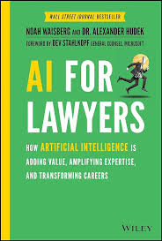
- Overview: Provides insights into how AI is transforming legal practice, with a focus on legal document automation and analysis.
- Key Topics: Contract analysis, legal AI tools, challenges in legal tech.

Slide 19
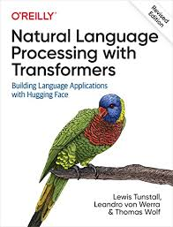
- Overview: A foundational book on NLP, essential for understanding how to process and analyze legal texts using Python.
- Key Topics: Text processing, linguistic data analysis, NLP libraries.

Slide 20
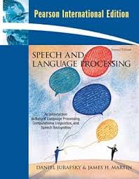
- Overview: A comprehensive text on speech and language processing, ideal for developing multilingual NLP models for the Indian legal system.
- Key Topics: Language modeling, information extraction, multilingual NLP.

Slide 21
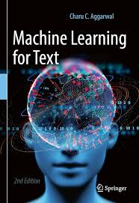
- Overview: Focuses on machine learning models for text processing, which is critical for legal applications like document analysis and case law summarization.
- Key Topics: Text classification, sequence models, topic modeling.

Slide 22

- Overview: A comprehensive resource on deep learning, covering models like RNNs, LSTMs, CNNs, and transformers that are crucial for building AI applications in law.
- Key Topics: Neural networks, sequence modeling, deep learning techniques.

Slide 23
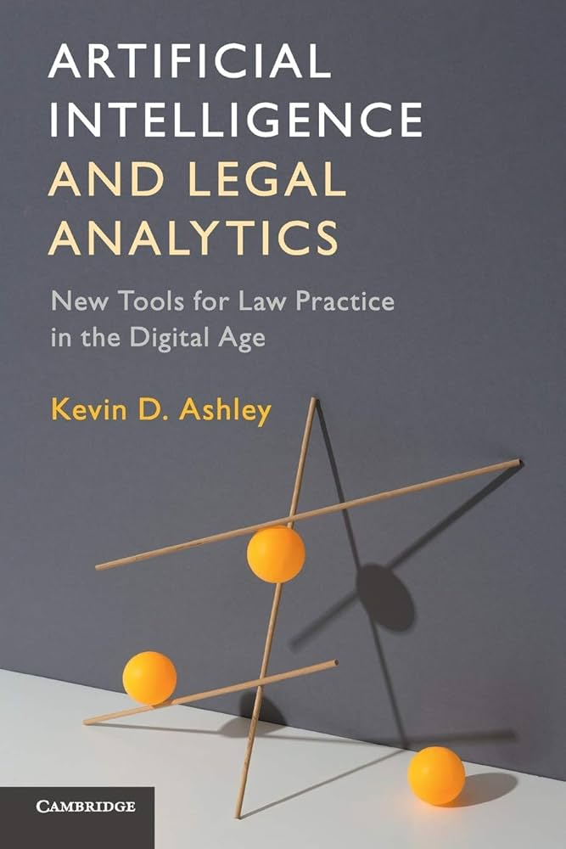
- Overview: Explores the intersection of AI and legal practice, including AI applications in legal research and analytics.
- Key Topics: Legal reasoning, predictive models, legal tech applications.

Slide 24
Identify the specific technologies being integrated, such as Natural Language Processing and machine learning.
--> Natural Language Processing (NLP) :-
This allows Lawyer.AI to understand legal questions and provide answers in natural language. It's essential for analyzing legal documents and giving real-time advice .
--> Machine Learning :-
This enables Lawyer.AI to learn from vast amounts of legal data, improving its accuracy in providing legal information and support .
--> Big Data Analytics :-
You'll need to store and process large datasets of legal information to train the machine learning models and provide comprehensive legal insights.

Slide 25
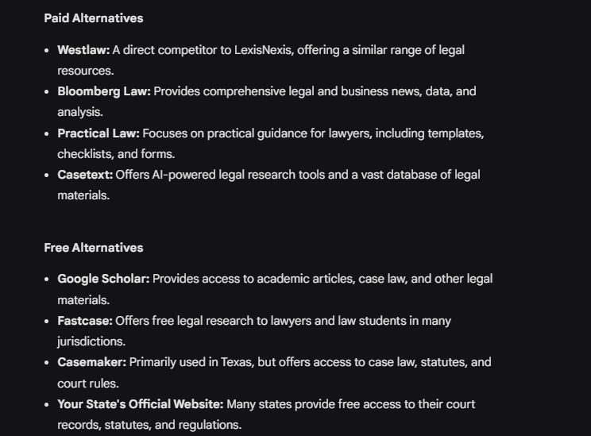
Case Study on Similar Platforms like LAWYER.AI

Slide 26
What is LexisNexis?
LexisNexis is a leading global provider of computer-assisted research and risk management services for professionals in the legal, accounting, corporate, government, law enforcement, tax, and academic markets. The company was founded in 1977 and is headquartered in New York City.

Slide 27
What does LexisNexis do?
LexisNexis provides a wide range of tools and services that help professionals make informed decisions, reduce risk, and improve productivity. Some of the key areas where LexisNexis works include : Legal Research: LexisNexis provides comprehensive and authoritative legal research tools, including case law, statutes, regulations, and secondary sources. Risk Management: LexisNexis offers risk management solutions that help organizations identify, assess, and mitigate risks associated with customers, vendors, and other third parties . Compliance: LexisNexis provides compliance solutions that help organizations manage regulatory requirements, reduce risk, and improve governance.

Slide 28
Investigations: LexisNexis offers investigative solutions that help law enforcement, government agencies, and private investigators gather and analyze information to solve cases . Business Intelligence: LexisNexis provides business intelligence solutions that help organizations gather and analyze information to make informed decisions.

Slide 29
How does LexisNexis work?
LexisNexis uses advanced technology and machine learning algorithms to gather, analyze, and deliver relevant information to its customers. The company's solutions are designed to help professionals : Search and analyze large datasets: LexisNexis provides powerful search and analytics tools that help professionals quickly find and analyze relevant information . Identify and mitigate risk: LexisNexis offers risk management solutions that help organizations identify and mitigate risks associated with customers, vendors, and other third parties. Stay up-to-date with regulatory requirements: LexisNexis provides compliance solutions that help organizations manage regulatory requirements and reduce risk . Gather and analyze information for investigations: LexisNexis offers investigative solutions that help law enforcement, government agencies, and private investigators gather and analyze information to solve cases.

Slide 30
Here are some example use cases for LexisNexis:
Law Firm: A law firm uses LexisNexis to conduct legal research and gather information for a case .
Bank: A bank uses LexisNexis to identify and mitigate risks associated with customers and vendors .
Government Agency: A government agency uses LexisNexis to gather and analyze information for an investigation .
Private Investigator: A private investigator uses LexisNexis to gather and analyze information for a client.

